Slide 1
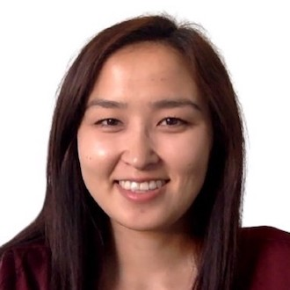
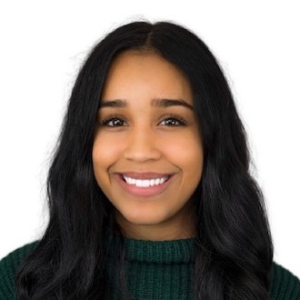
Light should be natural light from a window but not directly shining onto the subject. The face should be well-lit but not shiny.
The background should be empty and white. Use remove.bg/t/change-background.
With glasses, the head should be tilted slightly up or down to reduce any glares.
The head, neck, and hair should:
Fill up most of this gray rectangle
Not be higher than the top of the gray rectangle
Not be lower than the bottom of the gray rectangle
Be centered in the photo
Not be tilted to the side
Not have eyes, nose, or mouth covered by hair or a hat (exceptions for religious wear)
Photos must:
Be perfect squares no smaller than 1000 x 1000
Have a resolution of 200+
Be in the .png or .jpg format
Be titled in the following format: FirstName-LastName-2022-H2.png
Shirts/tops should:
Be solid (no patterns or logos)
Cover the shoulders and cleavage
Be saturated teal, cobalt blue, purple, pink, or maroon, similar to the following:
Please smile, ideally with some teeth!
Any necklaces should be simple and centered with the shirt’s neckline or the chest. It’s usually best to avoid necklaces, though. If you’re unsure about your photo, submitting a larger, more zoomed-out one is easier for us to crop correctly.
Shoulders should be equally represented and reach all the way to the edges of the square. For side photos, the head should be just slightly turned to the side without turning the shoulders.
No hands should show in the photo.

